Slide 1
Learning intention: to explore neuroplasticity, common neurotransmitters and the effects of epigenetics
Success criteria:
Describe the effects of main neurotransmitters
Describe how neuroplasticity changes over time
Describe epigenetics as heritability passed down in the structure/tags on DNA rather than the sequence

Slide 2
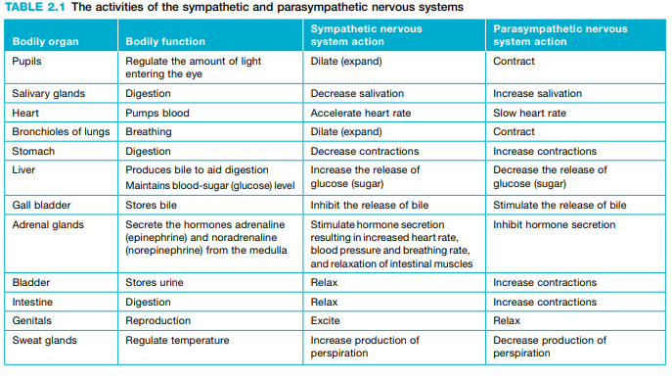

Slide 3
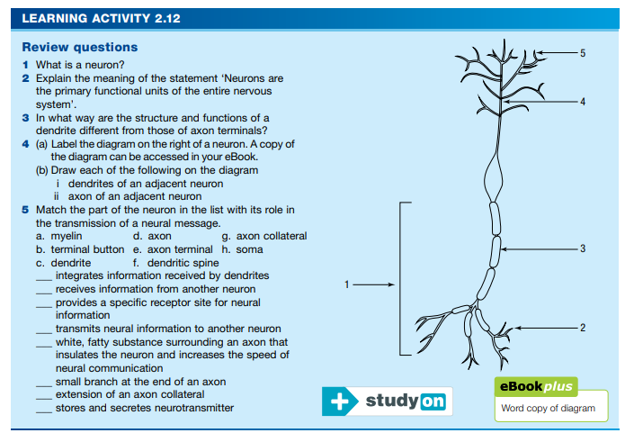

Slide 4
Glutamate – excitatory
-enhanced learning and memory
Gamma-amino butyric acid (GABA)
-Without the inhibitory effect of GABA, activation of postsynaptic neurons might get out of control.
-e.g. causing seizures similar to those of epilepsy and other problems.
-Anxiety symptoms such as those experienced by people with phobias have been connected to a low level of GABA in the brain

Slide 5
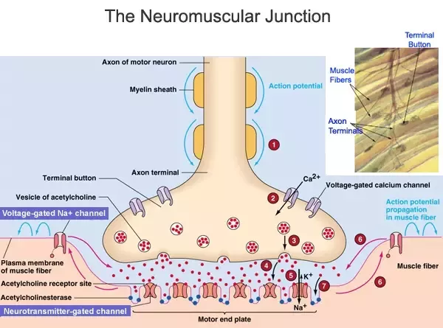
Acetylcholine - excitatory

Slide 6
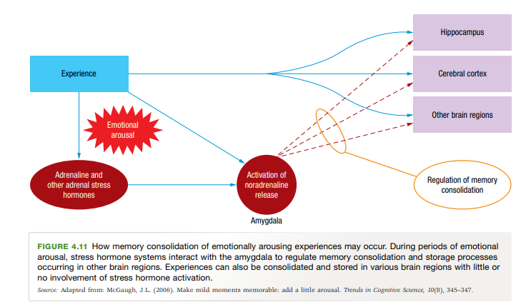
Adrenaline – consolidates memories of emotionally arousing experiences
Adrenaline = heart while noradrenaline = blood vessels

Slide 7
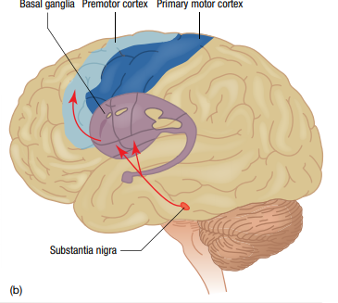
Parkinson’s disease
substantia nigra, located in the midbrain – controls voluntary muscle movements (e.g. for walking, talking, writing) and produces dopamine
-if damaged, less dopamine produced
-basal ganglia and motor cortex receive less messages
Only see symptoms after ~60% loss in the substantia nigra

Slide 8
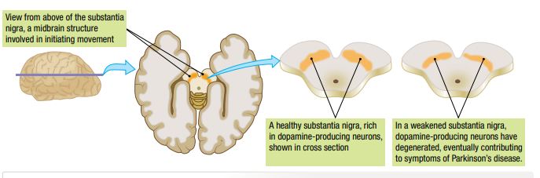
Two types of medications can be used — those that can be converted into dopamine by neurons and those that mimic the role of dopamine

Slide 9
Korsakoff’s disease
Damage to middle of brain near thalamus and frontal lobes
Often in alcoholics
Linked to low levels of vitamin B1/thiamine
Anterograde amnesia – unable to store new memories

Slide 10
